Slide 1
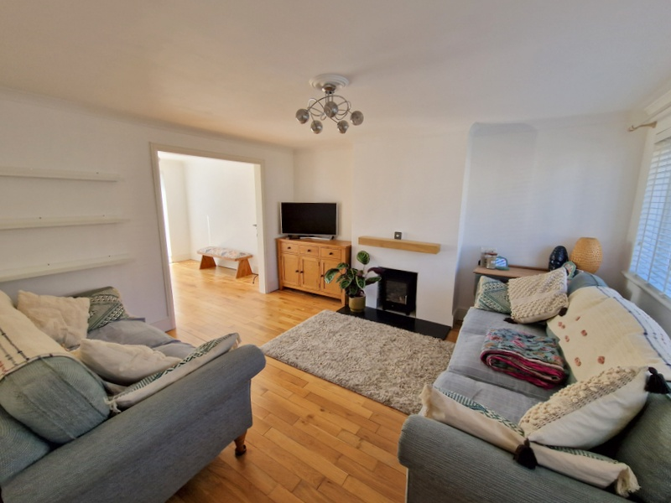
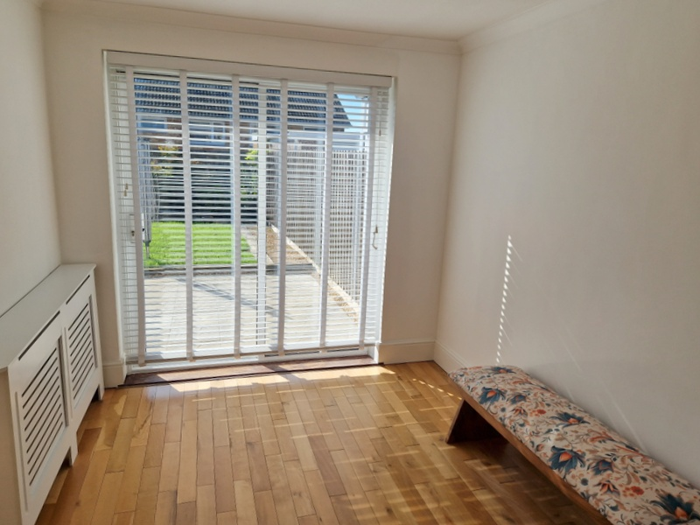
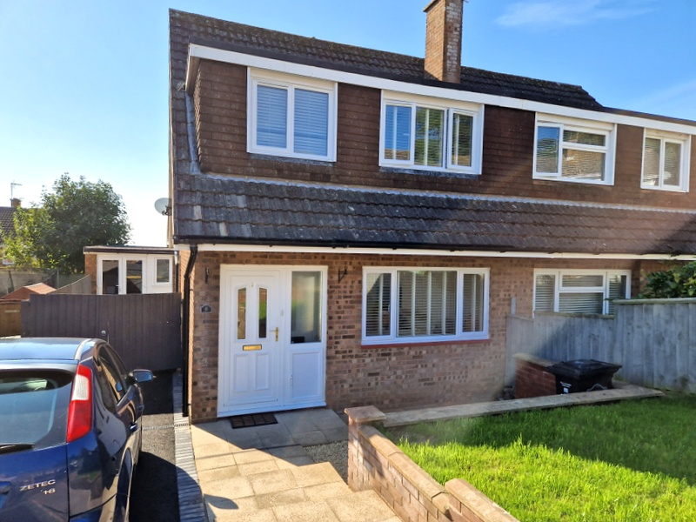
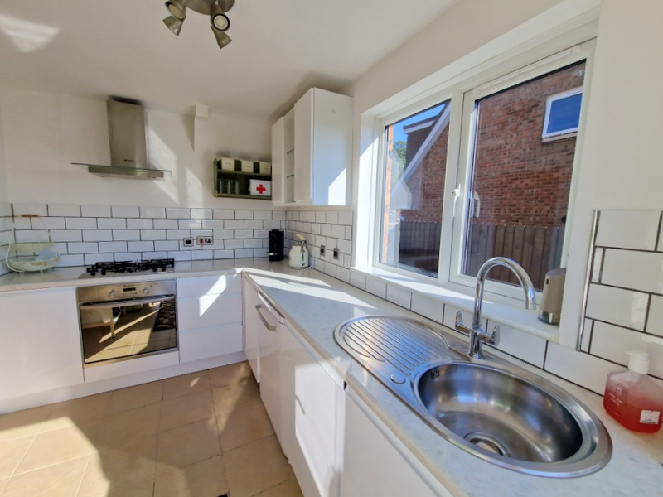
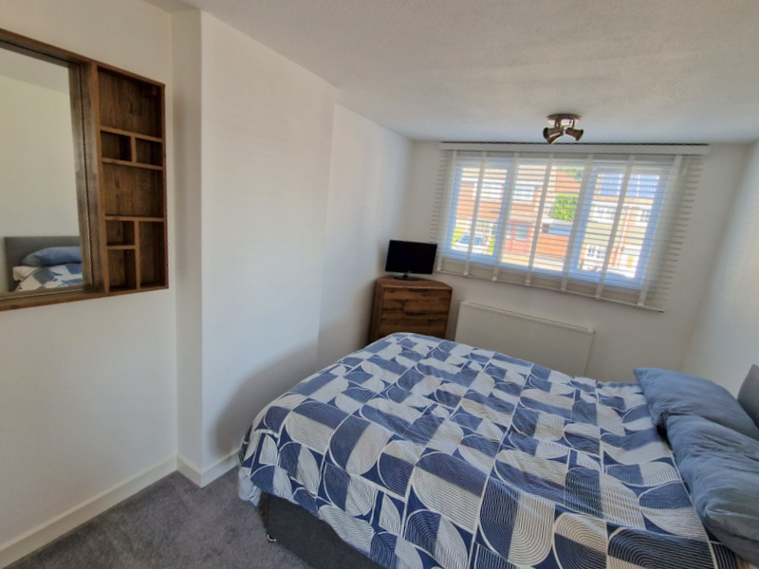
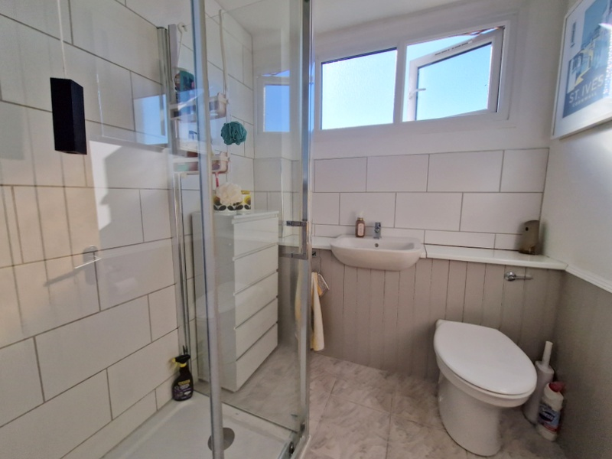
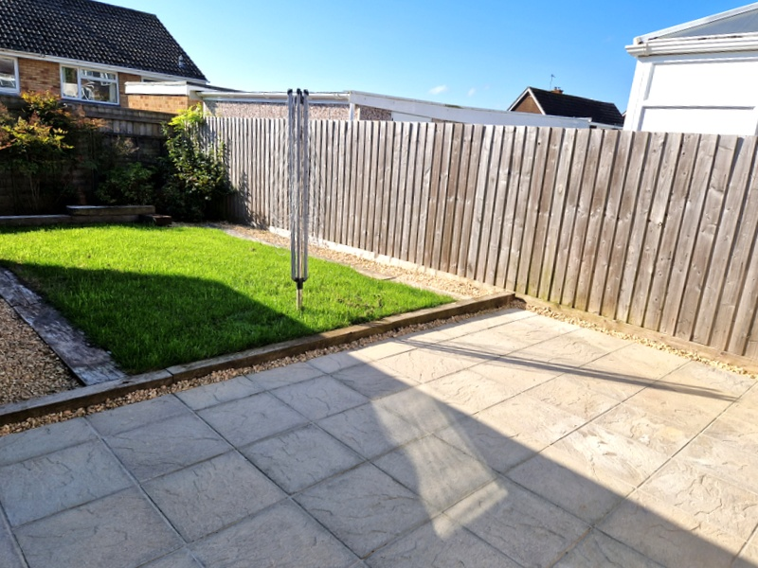
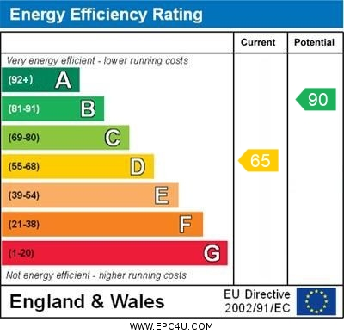
www.pennys.net
6 Little Meadow, Exmouth, EX8 4LU
GUIDE PRICE £320,000
TENURE Freehold
A Beautifully Presented Semi Detached House Offered For Sale With No Ongoing Chain, Situated In A Favoured Area Close To A Range Of Amenities, Landscaped Front And Rear Gardens, Long Driveway And Garage/Store/Studio, Viewing Is Highly Recommended
Lounge * Dining Room * Fitted Kitchen * Three Bedrooms * Modern Shower Room/Wc * Gas Central Heating Via Modern Boiler, Upvc Double Glazed Windows, Superb Family Home
Pennys Estate Agents Limited for themselves and for the vendor of this property whose agents they are give notice that:- (1) These particulars do not constitute any part of an offer or a contract. (2) All statements contained in these particulars are made without responsibility on the part of Pennys Estate Agents Limited. (3) None of the statements contained in these particulars are to be relied upon as a statement or representation of fact. (4) Any intending purchaser must satisfy himself/herself by inspection or otherwise as to the correctness of each of the statements contained in these particulars. (5) The vendor does not make or give and neither do Pennys Estate Agents Limited nor any person in their employment has any authority to make or give any representation or warranty whatever in relation to this property.
PENNYS ESTATE AGENTS
2 Rolle House, Rolle Street, Exmouth, Devon, EX8 2SN
Tel: 01395 264111 EMail: help@pennys.net

Slide 2
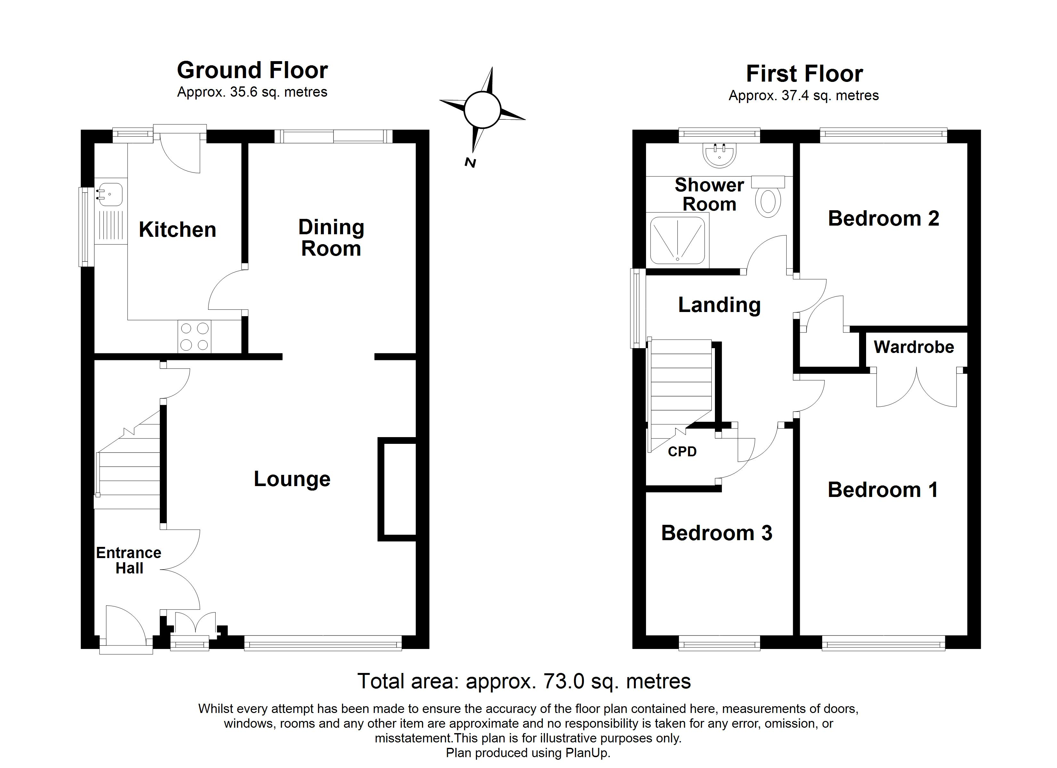
6 Little Meadow, Exmouth, EX8 4LU
THE ACCOMMODATION COMPRISES: uPVC front door with pattern window inset with entrance canopy over giving access to:
ENTRANCE HALL: With wood flooring, staircase rising to first floor, double doors to:
LOUNGE: 4.14m x 3.94m (13'7" x 12'11") A most attractive room with wood flooring, tiled chimney recess with marble hearth with wood beam over, TV point, cupboard housing meters, uPVC double glazed windows with fitted blinds overlooking the front aspect, radiator, access to understairs storage cupboard, opening to:
DINING ROOM: 3.18m x 2.51m (10'5" x 8'3") With wood flooring, radiator housed in feature radiator cover, sliding double glazed patio doors opening onto the rear garden, door to:
KITCHEN: 3.15m x 2.21m (10'4" x 7'3") Fitted range of patterned gloss finish work surfaces with inset circular single drainer sink unit with chrome mixer tap, cupboards with integrated washing machine and dishwasher (included in the sale) beneath. Upright fridge/freezer (included in the sale), uPVC double glazed windows to side and rear aspects, tiled flooring, uPVC double glazed door giving access to the rear garden.
FIRST FLOOR LANDING: Access to roof space, uPVC double glazed window to side aspect, radiator housed in feature radiator cover.
BEDROOM 1: 3.94m x 2.69m (12'11" x 8'10") With uPVC double glazed window to front aspect with fitted blinds, built-in double wardrobe with clothes rail and shelf, radiator.
BEDROOM 2: 2.82m x 2.79m (9'3" x 9'2") With radiator, built-in cupboard housing modern Ideal gas boiler for hot water and central heating, uPVC double glazed window to rear aspect enjoying pleasant open aspect with views towards the estuary and coastline beyond.
BEDROOM 3: 3.1m x 2.06m (10'2" x 6'9") With built-in cupboard over stairwell recess, radiator housed in feature radiator cover, uPVC double glazed window to front aspect with fitted blinds.
SHOWER ROOM/WC: 1.91m x 1.88m (6'3" x 6'2") Modern refitted suite with ease of access to shower cubicle with sliding shower splash screen door, shower unit with fixed rainfall head hose and detachable hose, wash hand basin set in display surface with WC beneath, tiled floor, tiled splashback areas, chrome heated towel rail, uPVC double glazed window with patterned glass.
OUTSIDE: To the front of the property there is a level lawned area of garden with a raised flower bed, decorative stone garden area with wide patio steps. Driveway providing ample off road parking, double wooden gates gives access to the rear garden and GARAGE/STORE/STUDIO. The rear garden has been landscaped, fully enclosed level and enjoys a sunny aspect with good size patio sun terrace areas ideal for outside entertaining, lawned garden edged with wooden sleepers and decorative stone pathway with flower and shrub beds and GARDEN SHED, outside cold water tap.
GARAGE/STUDIO: 5.49m x 2.74m (18'0" x 9'0") uPVC double glazed double doors and double glazed windows, power connected.
Mortgage Assistance: We are pleased to recommend Meredith Morgan Taylor, who would be pleased to help no matter which estate agent you finally buy through. For a free initial chat please contact us on to arrange an appointment. Your home may be repossessed if you do not keep up repayments on your mortgage. Meredith Morgan Taylor Ltd is an appointed representative of The Openwork Partnership, a trading style of Openwork Ltd which is authorised and regulated by the Financial Conduct Authority (FCA).
FLOOR PLAN:

